Slide 1

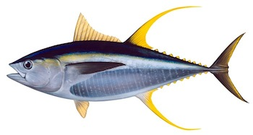

IOTC-2021-TCMP04-09
CURRENT STATUS OF IOTC
MANAGEMENT STRATEGY EVALUATIONS
Yellowfin Tuna
Dale Kolody & Paavo Jumppanen – CSIRO
With guidance from the IOTC WPM MSE Task Force

Slide 2

Yellowfin MSE Outline
Funding Support:
Phase 3 ends June 2021
Phase 4 funding from Australia confirmed to June 2023
CSIRO and Department of Foreign Affairs and Trade, Australia
Operating Model:
Not yet endorsed by WPTT, WPM and SC
Critical OM problems related to stock assessment problems
Tuning Objectives:
Proposed by TCMP 2019
Candidate Management Procedures (same as for bigeye tuna)
CPUE-based
Model-based “hockeystick” function
Model-based with projections (K2SM analogy)
TCMP-04 Feedback for next iteration

Slide 3
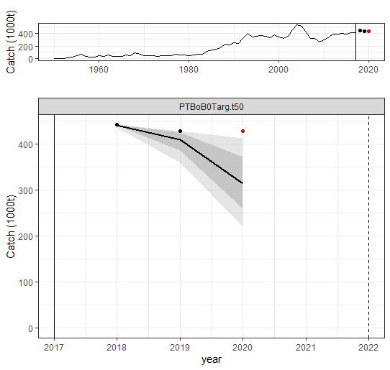
Current Yellowfin OM is not realistic: It cannot account for catches observed in 2018-2020
Historical Catch
Projected Catch
OM cannot remove observed and assumed catches, even with 20 X increase in F
Reported Catches 2018-2019
Assumed Catch 2020

Slide 4
Plan for Operating Model Revision
Co-ordinate with the 2021 stock assessment team effort to resolve shared data interpretation and modelling issues
If necessary, expand OM uncertainty dimensions in new directions
Seek endorsement for revised OM by SC 2021 or more likely 2022
Target adoption of first MP-based TAC setting in 2023 (for 2024 fishing year)

Slide 5
TCMP-03 (2019): 2 Tuning Objectives
Rebuild: SB_{T} ≥ SB_{MSY} in year T, in exactly 50% of simulations
Y2: Pr(SB(T=2029) ≥ SB(MSY) ) = 0.5
Y3: Pr(SB(T=2034) ≥ SB(MSY) ) = 0.5
(Y1: from TCMP-02 (2018) - rebuild by 2024 - dropped in 2019)
Biomass
Many ways to reach a single point
SB(MSY)
MP-B 50th percentile
MP-A 50th percentile
Year
Rebuilding
Target year

Slide 6
TCMP-03 (2019) MP development guidance
Other MP implementation constraints:
Frequency of quota setting
First MP setting: 2023 for 2024 quota year
Then every 3 years
TAC change constraints
Maximum 15% change (increase or decrease)
If not achievable – find limit that can achieve rebuilding
“…demonstrate how long rebuilding will take if TAC change constraints are limited to 15% [and alternative options at the discretion of the MP development team]…”
2 year Implementation data lag
E.g. 2022 CPUE available for 2024 TAC

Slide 7
Feedback requests for TCMP-04 (2021)
Tuning Objectives:
Rebuilding by 2029 or 2034
(Or 10 and 15y from first quota setting?)
Other MP implementation constraints:
Frequency of quota setting
First MP setting: 2023 (for 2024 TAC) ?
Then every 3 years?
3) TAC change constraints
Maximum 15% change (increase or decrease)
(If not achievable – find minimum that can achieve rebuilding)
Demonstrate how long rebuilding will take with 15% constraint (and sensible range of alternatives)
4) Other TCMP concerns?

Slide 8
Merci
Thanks!

Slide 9
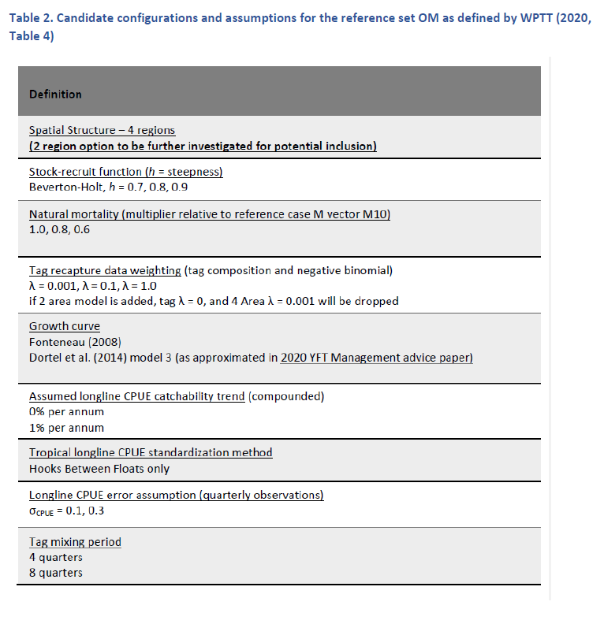
Yellowfin Operating Model – Reference Set Ensemble from IOTC-2021-WPM12(MSE)-03

